Slide 1
10.22 Meeting - 5
吳定洋
1

Slide 2

Table of contents
01
02
RTT related work
Wi-Fi CSI traffic APP (update)
03
Next Step
2

Slide 3

01
RTT related work
The progress this week
3

Slide 4
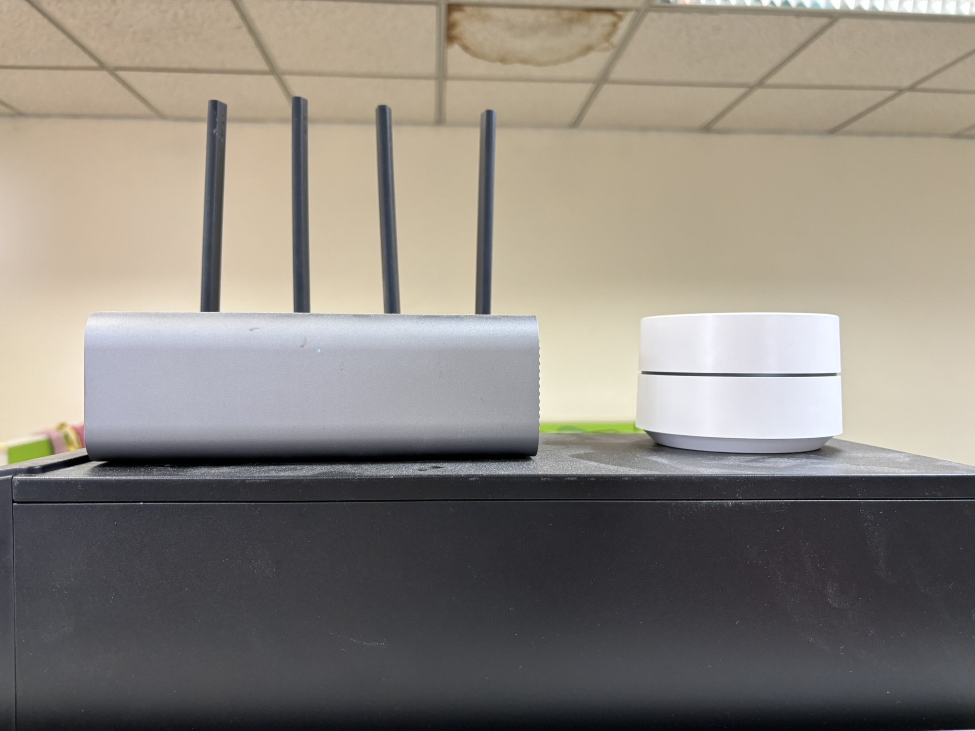
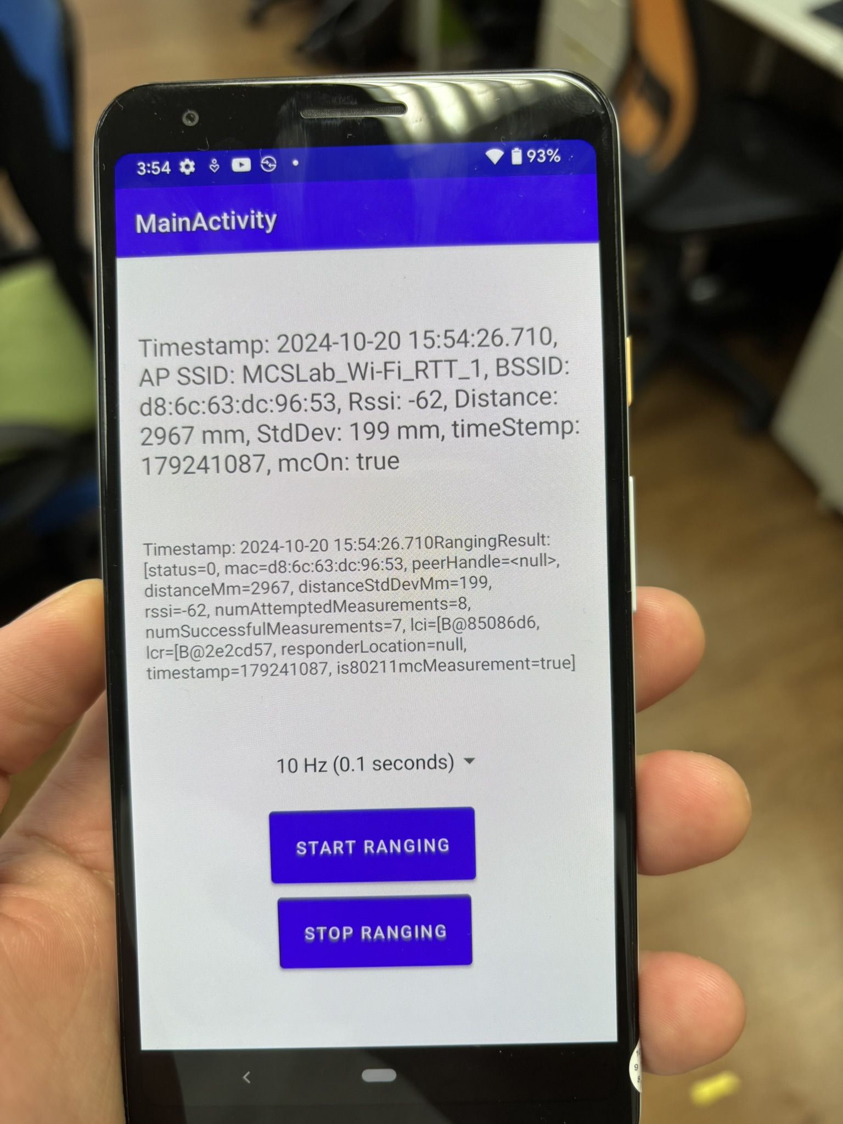
Wi-Fi AP and google pixel3 co-work
4

Slide 5
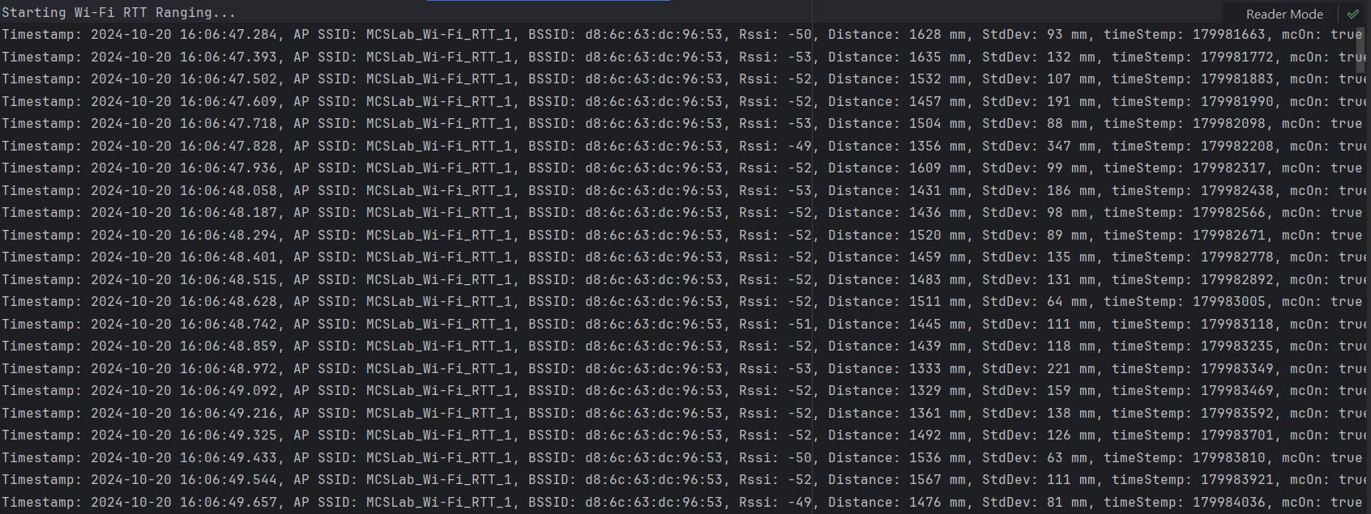
Google pixel3 FTM data collect
5

Slide 6

02
Wi-Fi CSI traffic APP (update)
A feature to make it easier to use
6

Slide 7
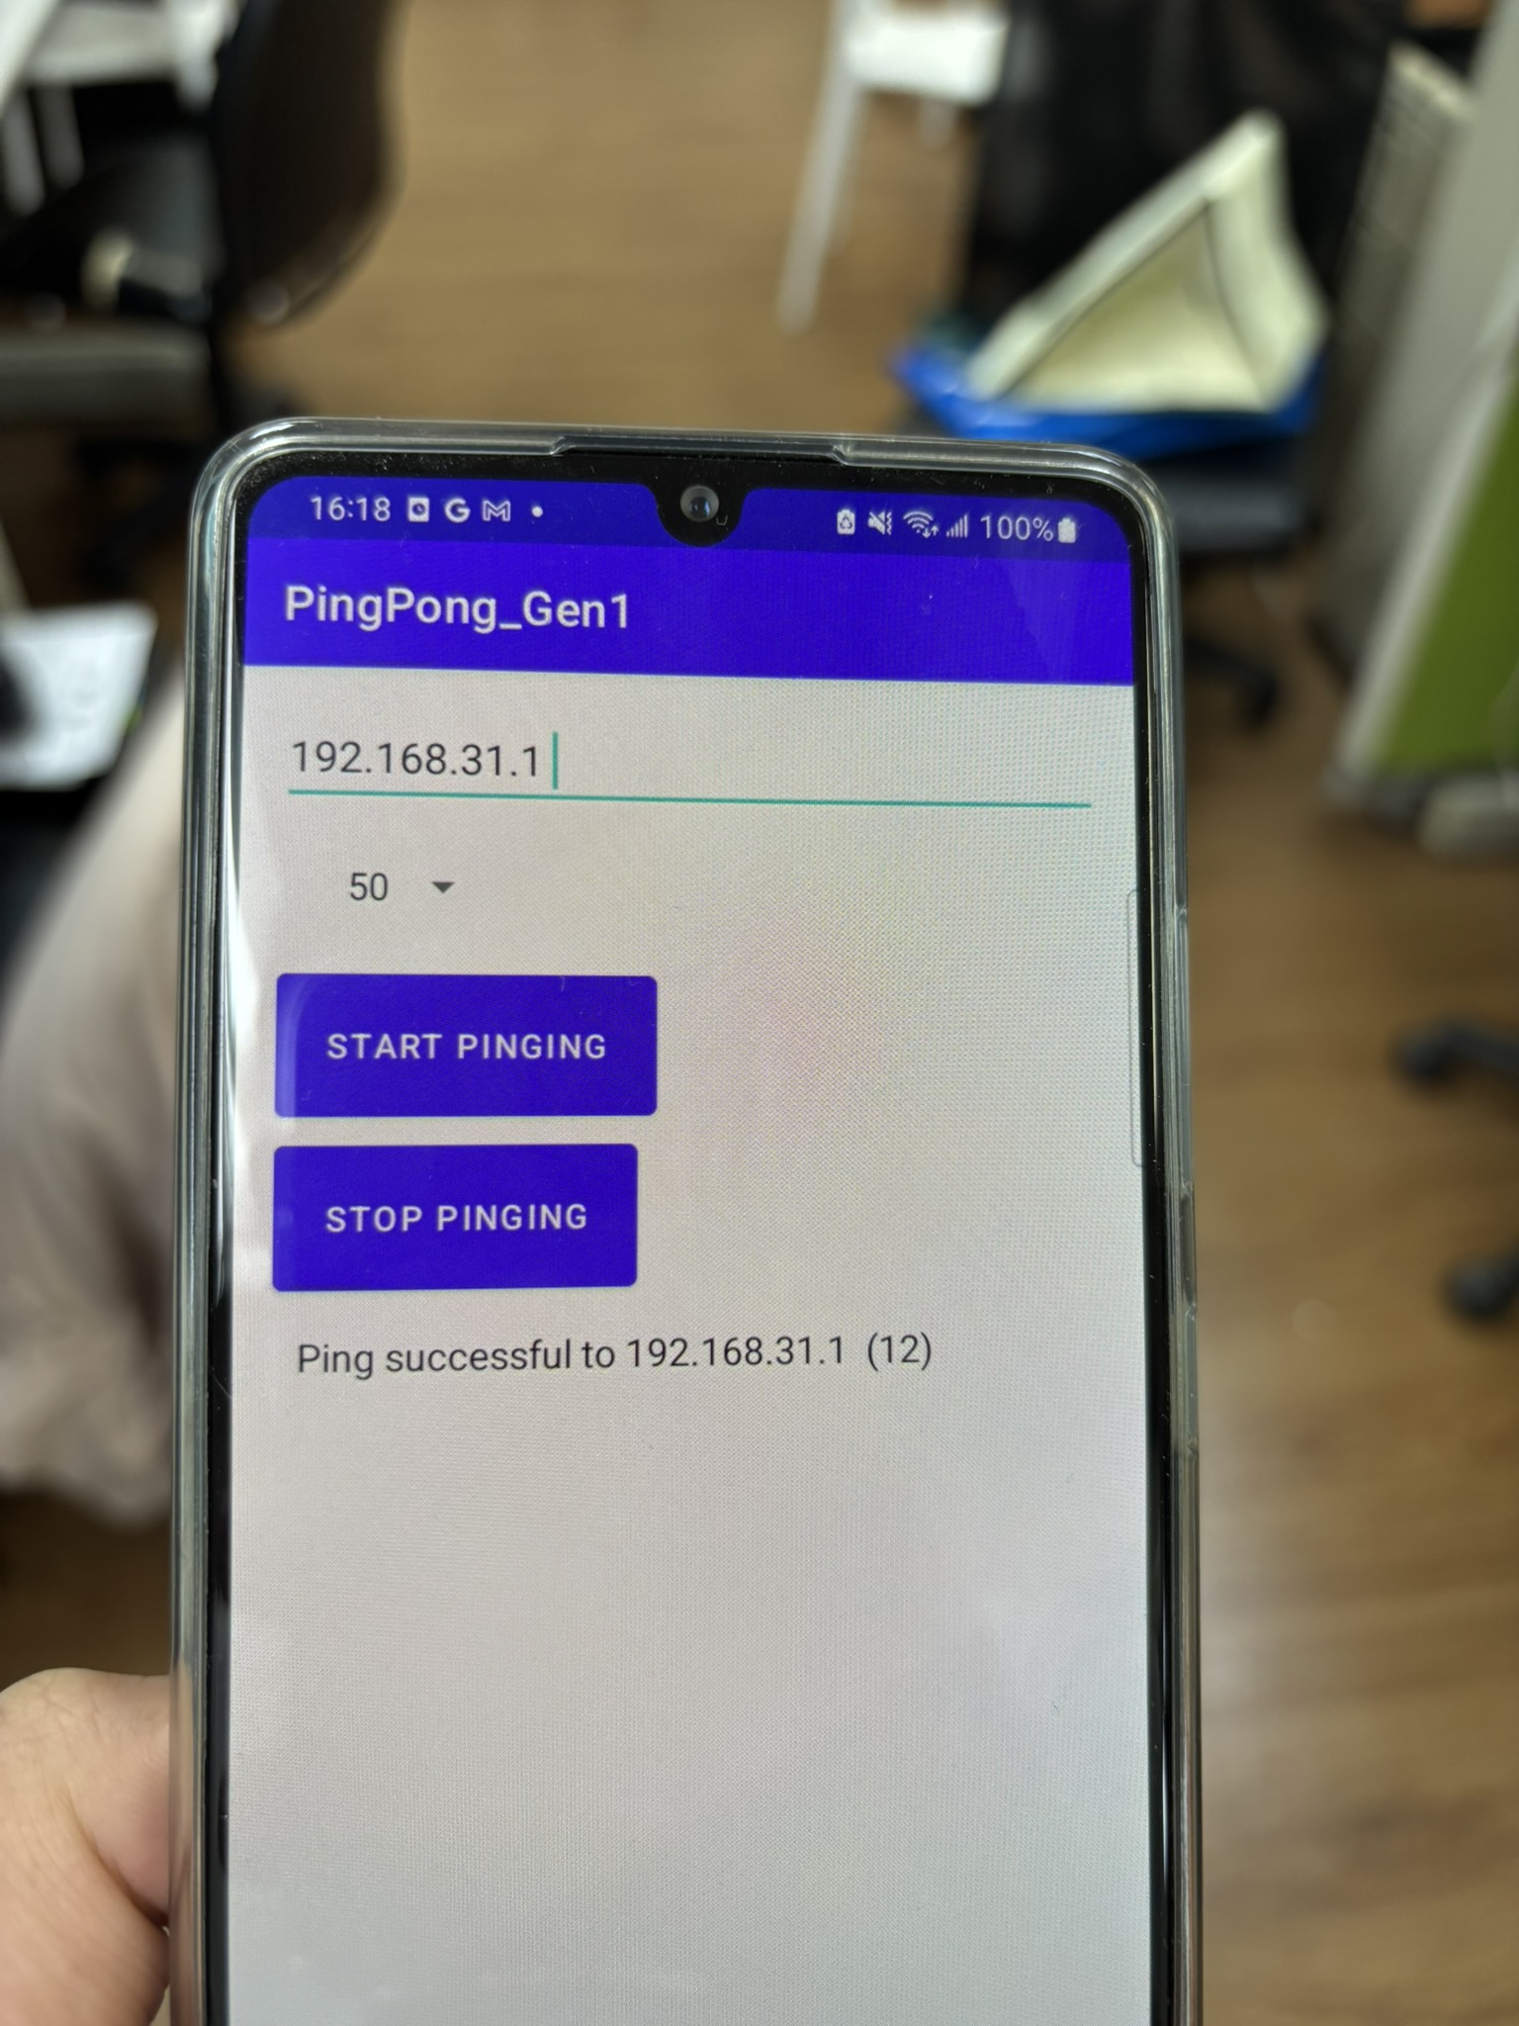
APP (Update)
7

Slide 8

03
Next Step
8

Slide 9
Experiment thought (1)
Limitation
We only have 1 AP that support 802.11mc
Solution (temp.)
Fix the AP at point A.
Collect data from all RPs in the laboratory.
Move the AP to point B after completing data collection at point A.
Collect data from all RPs again at point B.
Repeat until the required number of data points are collected.
Stack all collected data together for use.
9

Slide 10
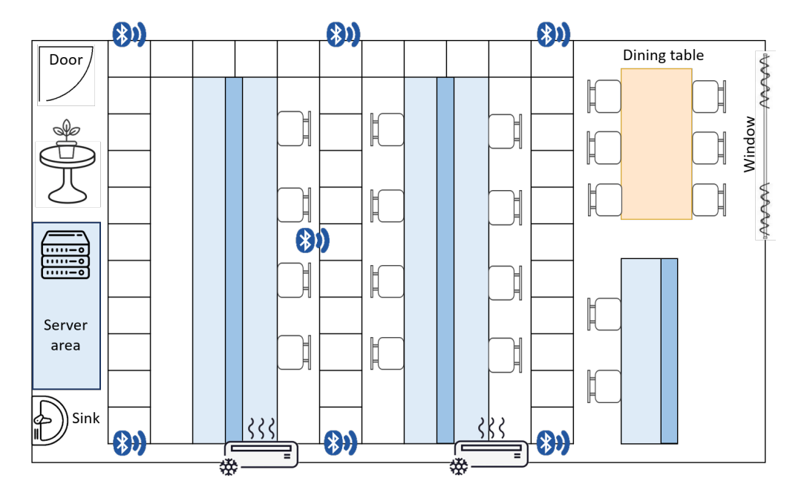
Experiment thought
A
B
C
D
E
F
G
10

Slide 11
Experiment thought (2)
A method that can use one-side FTM
A paper mentions that even if the AP does not support 802.11mc, Android 12 and later versions support one-side FTM.
However, the drawback is that it is significantly less accurate compared to two-side FTM.
11

Slide 12

Thanks for Listening!
13

